Slide 1
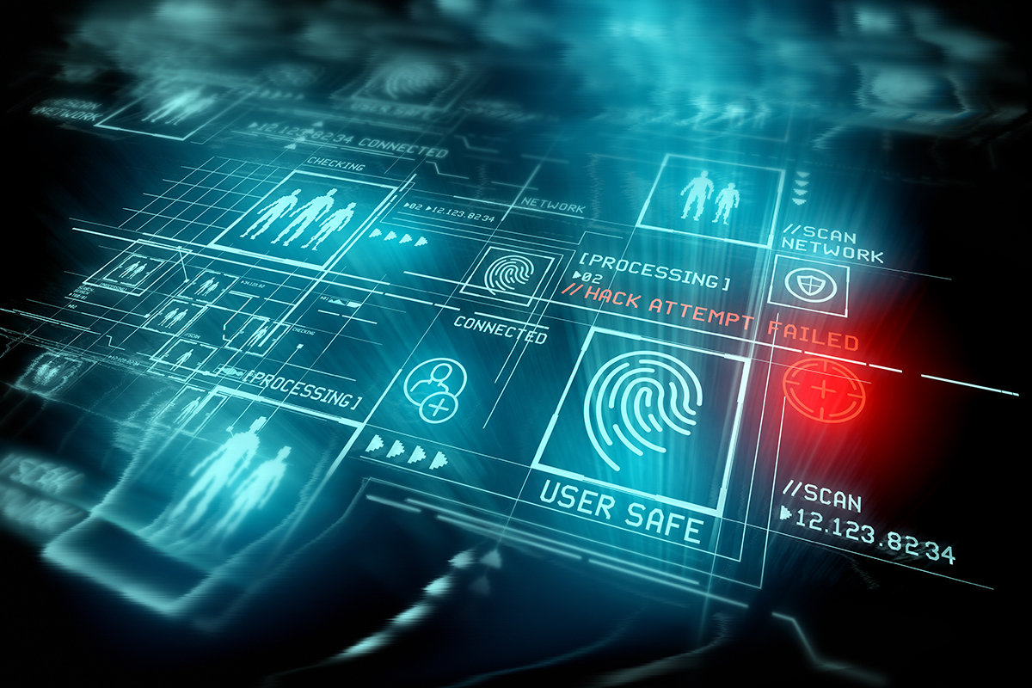
Biometric Security Systems
V.Jathushan
IT20200510

Slide 2


Agenda
Abstract
Introduction to the Biometric Security system
Evolution of the biometric security systems
THE FUTURE OF BIOMETRIC SECURITY
Conclusion

Slide 3
Abstract
Biometrics is the use of biological traits or behavioral traits to verify a person's identity. Biometric authentication is becoming increasingly popular as a reliable alternative to password-based security systems. It describes, how biometric technologies works and also discuss their benefits and risks when used in biometric security system. This article discusses the biometric system and its functions. Various biometric technologies are also discussed and compared. This Assignment describes the history of biometric security system, At what period did it start, What kind of evolution is there in each period. It also describes a detailed description of the new technology and it’s functions. This assignment discussed the benefits of biometric invention during this period.

Slide 4
Introduction to the topic
What Does Biometric Security Mean Lights out
How Does Biometric Authentication Work Proceed toward the woods
What benefits do biometric security systems offer?
What are the risks of biometric security

Slide 5
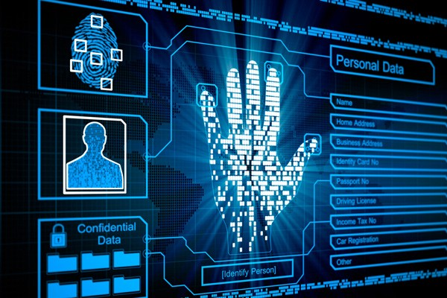
What Does Biometric Security Mean?
Biometric security is a security mechanism used to authenticate and provide access to a facility or system based on the automatic and instant verification of an individual's physical characteristics.
Biometric security is mainly implemented in environments with critical physical security requirements or that are highly prone to identity theft. Biometric security-based systems or engines store human body characteristics that do not change over an individual's lifetime. These include fingerprints, eye texture, voice, hand patterns and facial recognition.
An individual's body characteristics are pre-stored in a biometric security system or scanner, which may be accessed by authorized personnel. When an individual walks into a facility or tries to gain access to a system, the biometric scanner evaluates his/her physical characteristics, which are matched with stored records. If a match is located, the individual is granted access.

Slide 6
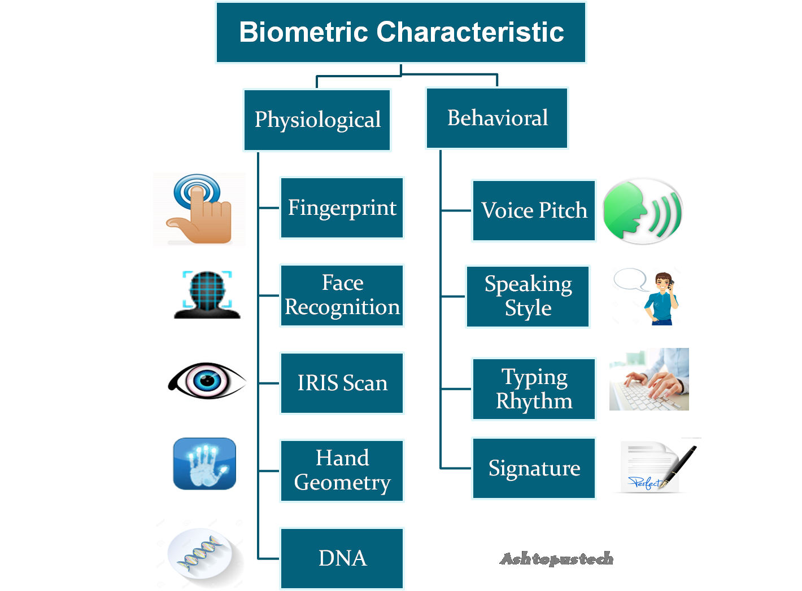
What Does Biometric Security Mean?
“Automated measurement”
No human involvement.
Comparison takes place in Real-Time.
Physiological and/or behavioral characteristics in biometric security

Slide 7
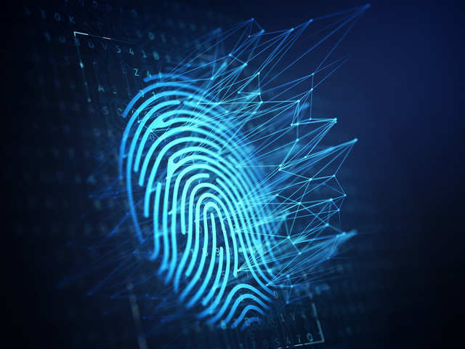
How Does Biometric Authentication Work?
Biometric authentication is on the cutting edge of modern life. These systems are varied and can protect people from having their identity and information stolen.
Fingerprint Scanners and How They’re Stored
The most common form of biometric scanners that are out there today is fingerprint scanners. These are usually seen in the form of a scanner that is on a smartphone or tablet that can take your fingerprint, read it, and test it against what is stored in the database. Typically, the fingerprint is scanned and from there it goes into what Android calls a Trusted Execution Environment. The information is stored in that isolated section of hardware until it is called upon by the right authentication program to gain access. You can’t even root or use a bootloader to get access to that data!

Slide 8
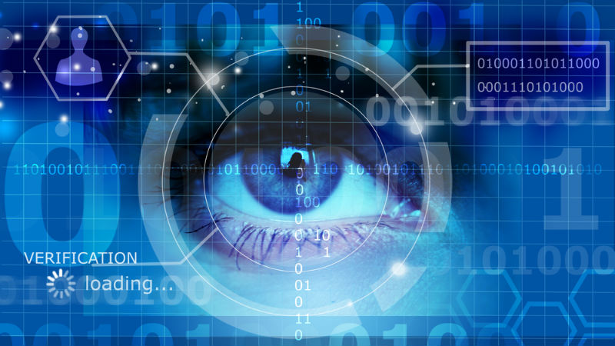
How Does Biometric Authentication Work?
Eye Scanners
Eye Scanners Another great form of technology to help people is an eye scanner. Iris scan fake is very difficult. The iris has a very unique shape from person to person, so the chances of you meeting someone with the same iris shape are almost impossible. Eye scanners are a bit more advanced than this, but you will find that they operate in safer environments around the world.

Slide 9
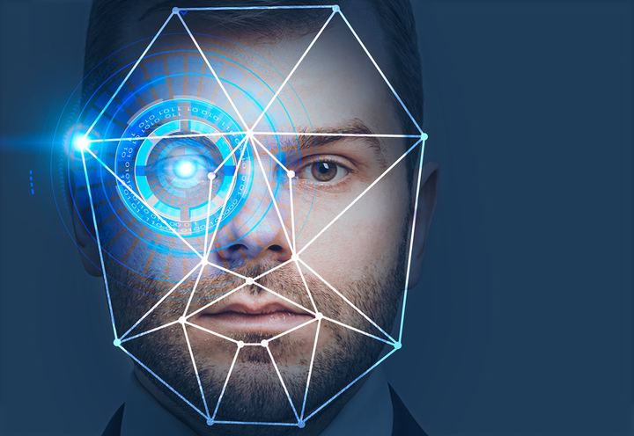
How Does Biometric Authentication Work?
Facial recognition systems
Facial recognition technology is the most common, Phones already use people's access to their accounts. According to the latest generation of phones that have been released, facial recognition systems are capable of saying a lot of similarities on the face but avoiding them. This is the most effective form of biometrics, Because all it takes is a small scan and instant access to your phone, device and more. However, there is a drawback, which is that the lights in a particular situation will not give you access to your account. However, it is only with the lower level of technology and not at the highest levels.

Slide 10
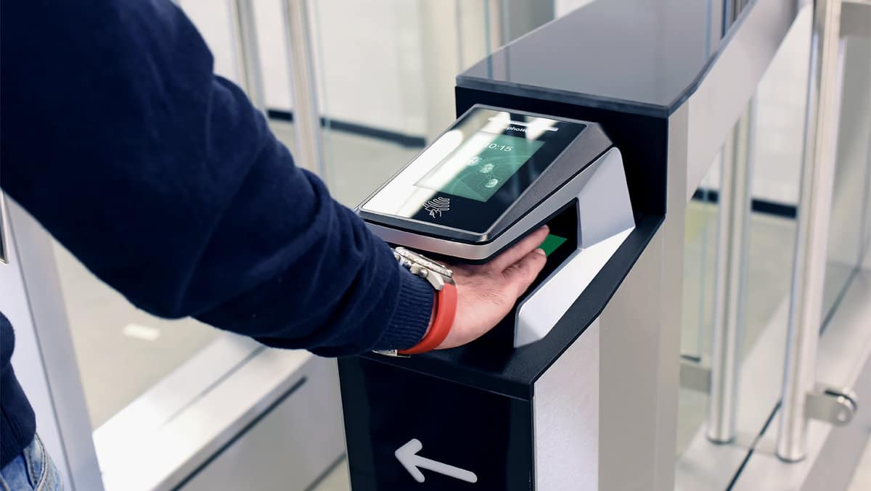
How Does Biometric Authentication Work?
Hand Geometry Recognition
Hand geometric biometric systems use features such as finger length, finger width, finger thickness, finger area and palm width for personal recognition. These systems have gained great popularity and general acceptance from extensive deployment of applications in access control, time-visiting applications and many verification tasks.

Slide 11

How Does Biometric Authentication Work?
voice recognition biometric system
Voice recognition (also called speaker recognition or voice authentication) applies analyzes of a person’s voice to verify their identity. Airways and soft-tissue cavities, as well as the shape and movement of the mouth and jaw, influence voice patterns to create a unique “voiceprint.”
Speaker recognition is a type of voice recognition technology. However, it is not the same as speech recognition, which is the technology used in speech-to-text applications and virtual assistants like Siri or Alexa. Speech recognition can make sense of verbal language, but it can’t verify the identity of the speaker based on his or her unique vocal attributes; voice biometrics can.

Slide 12
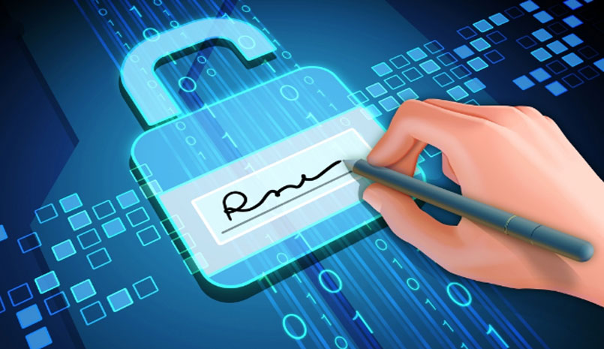
How Does Biometric Authentication Work?
Signature-Based Biometric Authentication
Handwritten signature has a long history as a mean to verify the identity of a user for applications like document authentication, credit card transactions, cheque verification, attendance recording, and forensics. Although signature is still used to verify the identity of an individual by visual inspection, a constantly growing interest by both academia and industry has lead to the development of systems for automatic signature-based user verification. Nowadays, signature is one of the most accepted biometrics since it is perceived as a noninvasive and nonthreatening characteristics by the majority of the users being the act of signing part of everyday life. A signature can be easily acquired either using a classic ink pen or..

Slide 13
What benefits do biometric security systems offer?
Quick and Accurate Identification and Authentication
Using passwords and codes for security access is pretty straightforward but generic. Anyone with a card or pass can gain access. But biometric security technology refers to the biological passcodes that cannot be forged - meaning accurate identification and authentication of the specific individual. Iris or facial recognition is more often becoming integrated as part of the security process, as scanning is a quick and easy process.
biometric systems strengthen security
One of the key benefits of biometric security devices is that they can help to increase your protection. It’s much harder, for example, to clone or steal a fingerprint than an access card.
In situations where you need to increase security, biometrics can also be used for multi factor verification. After someone’s presented their badge, for example, they then need to present their fingerprint to verify that they are who they claim to be. This is safer than using a PIN for verification as that can easily be passed to other people.
Biometric systems improve convenience
Biometric security systems can also offer users more convenience. It’s easy to forget a card or key, but you always have your biometrics with you. Once the biometric test is activated, all fingerprints, iris and facial recognition are done - and employees are good to go. It is even convenient to log the data and audit it accordingly.

Slide 14
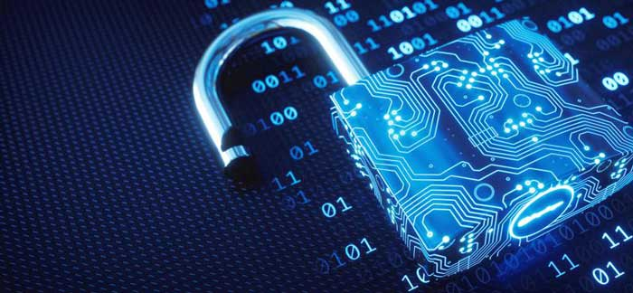
What benefits do biometric security systems offer?
Easy to Operate and User Friendly
Managing, fitting and even analyzing biometric verification is very user-friendly – providing technological and accurate results with minimaI need for intervention. New data can be entered quickly and logs analyzed fast. Once the table of entry and exits is created, it’s easy to study and manage.
Additional Capacity to Accommodate Growth
As companies evolve, it’s critical for security to grow along with it. One major advantage of biometric verification is the ability to scale. These systems are highly flexible, and can easily accept additional employee's data. This means security grows as the firm scales.

Slide 15
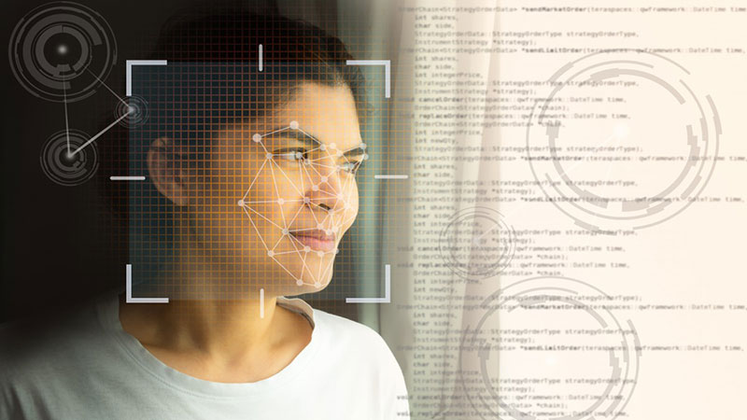
What are the risks of biometric security?
Costs
It’s no surprise that a more advanced security system would require significant investments and costs to implement. In a 2018 survey by Spiceworks, 67 percent of IT professionals cite cost as” the biggest reason for not adopting biometric authentication.” Transitioning to a biometrics authentication wouldn’t be the only thing a company would have to pay for, with 47% of the surveyed stating a need to upgrade current systems in order to support a shift to biometric authentication on their devices.
Data breaches
Businesses and governments that collect and store users’ personal data are under constant threat from hackers. Because biometric data is irreplaceable, organizations need to treat sensitive biometric data with increased security and caution – something that’s expensive and technically difficult in order to stay ahead of fraud advancements. If a password or pin is compromised, there’s always the possibility of changing it. The same can’t be said for a person’s physiological or behavioral biometrics.

Slide 16
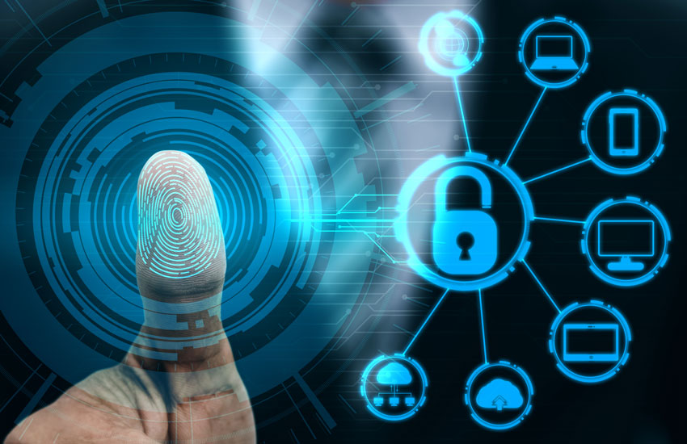
What are the risks of biometric security?
racking and data
As the world increases its use of biometric authentication systems like facial recognition technology and other biometric security measures, privacy of users needs to be taken into consideration. When biometrics are converted into data and stored, particularly in places or countries that have large surveillance measures, a user runs the risk of leaving a permanent digital record that can be potentially tracked by nefarious actors. In many instances, organizations and governments have used facial recognition software to track and identify people with scary accuracy that significantly inhibits privacy[3]. As surveillance increases, biometric data can become a permanent digital tag that can be used to track someone, both with and without their knowledge.
False positives and inaccuracy
Most common biometric authentication methods rely on partial information to authenticate a user’s identity. For example, a mobile biometric device will scan an entire fingerprint during the enrollment phase, and convert it into data. However, future biometric authentication of the fingerprint will only use parts of the prints to verify identity so it’s faster and quicker. In 2018, a research team from New York University created an Artificial Intelligence platform that was able to fraudulently crack fingerprint authentication at a success rate of 20% by matching similarities of partial prints to the full biometric data

Slide 17
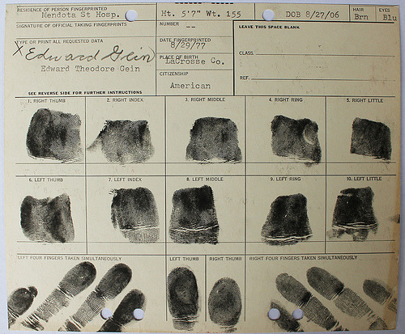

Evolution of the biometric security systems
16

Slide 18
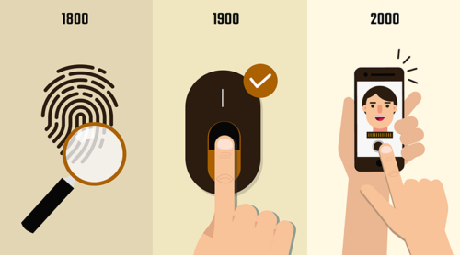
Evolution of the biometric security systems
Just hearing the term biometrics, we draw a picture of the fingerprint in the back of our mind, but, originally biometrics is a term related to our human body itself. The original term “Biometrics” actually refers to measurements and different sorts of calculations that are related to the human body. It is the measurement of human characteristics in a matrix form. Biometric measurements are unique and irreversible depending on their types. This is why in modern day identification biometrics measurements ensure maximum efficiency.
The term “biometrics” is derived from the Greek words “bio” (life) and “metrics” (to measure). Automated biometric systems have only become available over the last few decades, due to significant advances in the field of computer processing. Many of these new automated techniques, however, are based on ideas that were originally conceived hundreds, even thousands of years ago.

Slide 19

Evolution of the biometric security systems
Throughout the history of civilization many biometrics proof’s have been used as a formal recognition method
Many paintings have been made by prehistoric people who lived there in cave which is about 30000 years old. There are numerous handprints around these paintings that make it feel like an unforgettable signature of it’s creator
There is evidence that fingerprints were used as a sign of a persons as early as 500years ago, Babilenian trades were recorded on clay tablets containing fingerprints.
The 14th century Persian book “Jaamehol-Tawarikh” includes comments about the practice of identifying persons from their fingerprints.
In early Egyptian history, traders were identified by their physical descriptors to differentiate between trusted traders of known reputation and previous successful transactions, and those new to the market

Slide 20
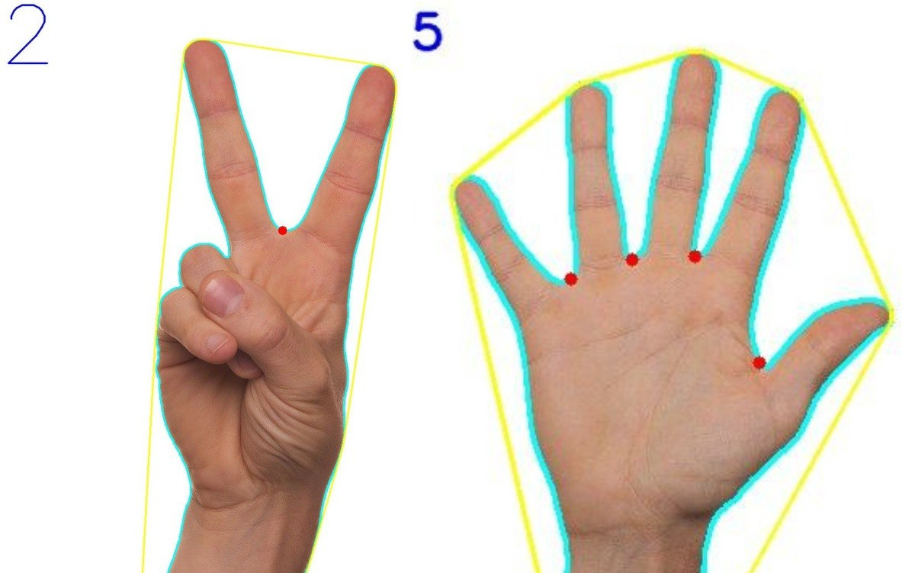
Evolution of the biometric security systems
Timeline of Biometrics security History
1858 – First systematic capture of hand images for identification purposes is recorded
Sir William Herschel, working for the Civil Service of India, recorded a handprint on the back of a contract for each worker to distinguish employees from others who might claim to be employees when payday arrived. This was the first recorded systematic capture of hand and finger images that were
1883 – Twain writes about fingerprints in “Life on the Mississippi”
In “A Thumb-Print and What Came of It,” one of the stories serialized in Mark Twain’s “Life on the Mississippi” the author wrote about fingerprints, and described a process for taking them. In 1894’s “The Tragedy of Pudd’nhead Wilson”, Twain again mentions the use of fingerprints for identification. In the story, a man on trial calls on the comparison of his fingerprints to those left at the crime scene to prove his innocence.

Slide 21
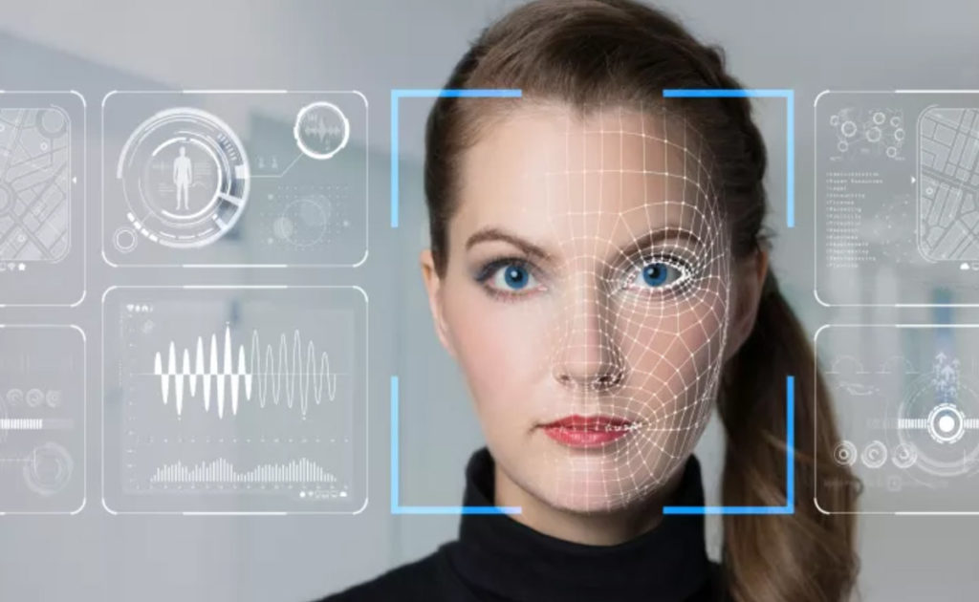
Evolution of the biometric security systems
1903 – Bertillon System collapses
Two men, determined later to be identical twins, were sentenced to the US Penitentiary at Leavenworth, KS, and were found to have nearly the same measurements using the Bertillon system. Although the basis of this story has been subsequently challenged, the story was used to argue that Bertillon measurements were inadequate to differentiate between these two individuals.
1960s – Face recognition becomes semi-automated
The first semi-automatic face recognition system was developed by Woodrow W. Bledsoe under contract to the US Government. This system required the administrator to locate features such as eyes, ears, nose and mouth on the photographs. This system relied solely on the ability to extract useable feature points. It calculated distances and ratios to a common reference point that was compared to the reference data.
1960 – First model of acoustic speech production is created
A Swedish Professor, Gunnar Fant, published a model describing the physiological components of acoustic speech production. His findings were based on the analysis of x-rays of individuals making specified phonic sounds. These findings were used to better understand the biological components of speech, a concept crucial to speaker recognition.

Slide 22
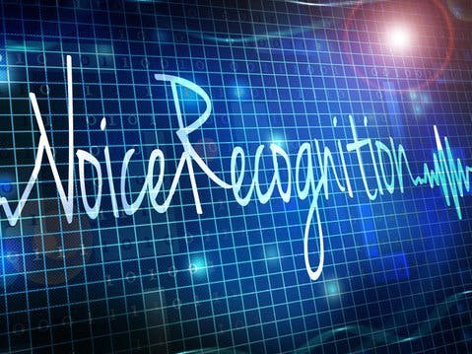
Evolution of the biometric security systems
1965 -Automated signature recognition research begins
North American Aviation developed the first signature recognition system in 1965.
1970s – Face Recognition takes another step towards automation
Goldstein, Harmon, and Lesk used 21 specific subjective markers such as hair color and lip thickness to automate face recognition. The problem with both of these early solutions was that the measurements and locations were manually computed.
1970 – Behavioral components of speech are first modeled
The original model of acoustic speech production, developed in 1960, was expanded upon by Dr. Joseph Perkell, who used motion x-rays and included the tongue and jaw. The model provided a more detailed understanding of the complex behavioral and biological components of speech.
1985 – Concept that no two irides are alike is proposed
Drs. Leonard Flom and Aran Safir, ophthalmologists, proposed the concept that no two irides are alike.

Slide 23
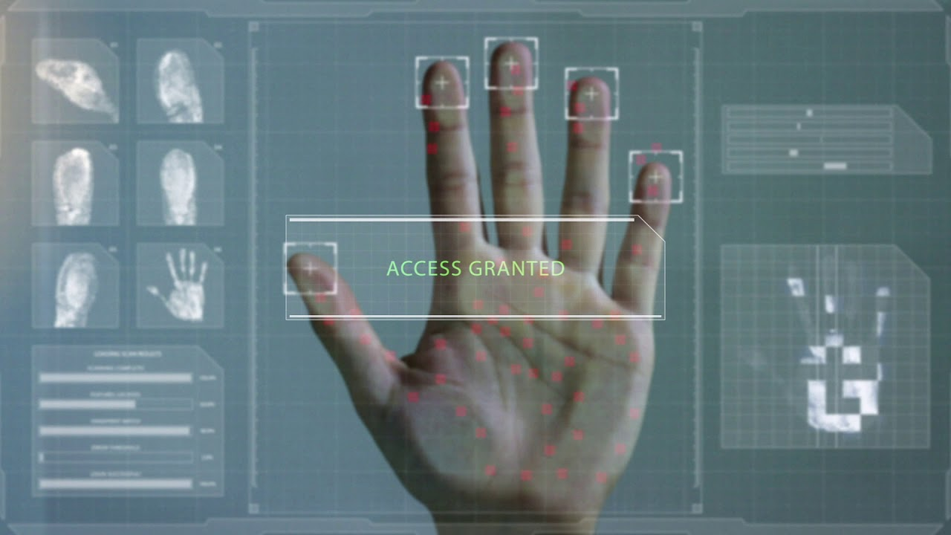
Evolution of the biometric security systems
1988 – Eigenface technique is developed for face recognition
Kirby and Sirovich applied principle component analysis, a standard linear algebra technique, to the face recognition problem. This was a milestone because it showed that less than one hundred values were required to approximate a suitably aligned and normalized face image.
1993 – FacE REcognition Technology (FERET) program is initiated
The FacE REcogntion Technology (FERET) Evaluation was sponsored from 1993-1997 by the Defense Advanced Research Products Agency (DARPA) and the DoD Counterdrug Technology Development Program Office in an effort to encourage the development of face recognition algorithms and technology.
1994 – Palm System is benchmarked
The first known Automated Fingerprint Identification Systems (AFIS) system built to support palm prints is believed to have been built by a Hungarian company known as RECOWARE Ltd. In late 1994, latent experts from the United States benchmarked this

Slide 24
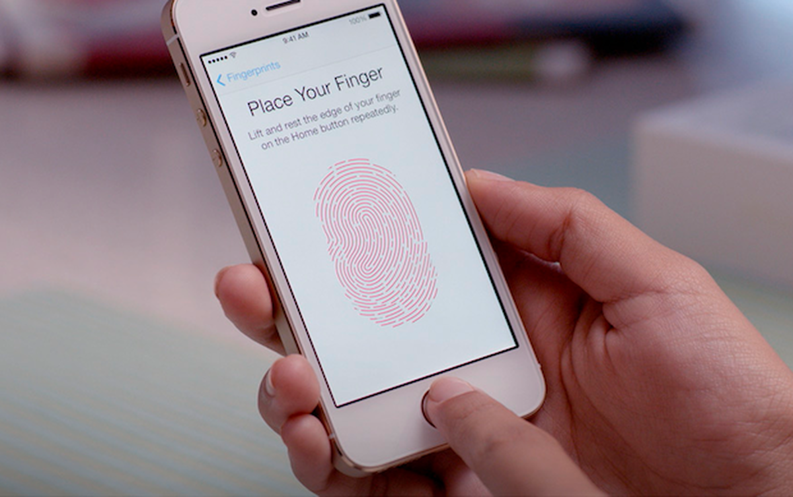
Evolution of the biometric security systems
2001 – Face recognition is used at the Super Bowl in Tampa, Florida
A face recognition system was installed at the Super Bowl in January 2001 in Tampa, Florida, in an attempt to identify “wanted” individuals entering the stadium. The demonstration found no “wanted” individuals but managed to misidentify as many as a dozen innocent sports fans.
2011 – Biometric identification used to identify body of Osama bin Laden
Along with DNA, the CIA used facial recognition technology to identify the remains of Osama bin Laden with 95 percent certainty.
2013 – Apple includes fingerprint scanners into consumer-targed smartphones
Touch ID is a fingerprint recognition feature, designed and released by Apple Inc., that was made available on the iPhone 5S, the iPhone 6 and iPhone 6 Plus, the iPad Air 2, and the iPad Mini 3. Touch ID is heavily integrated into iOS devices, allowing users to unlock their device

Slide 25
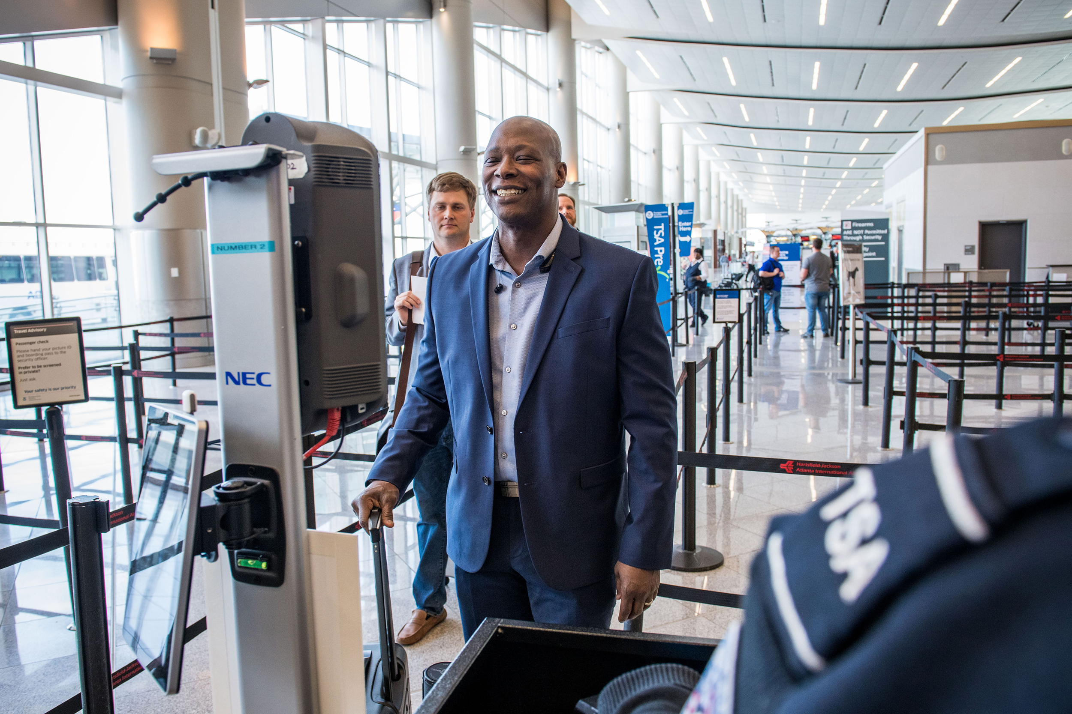
The Evaluation of biometric security in present time period
1. Airport Security
Biometric technology has been in airports for some time. The goal is to make travel through airports as unobtrusive as possible shared by airports around the world. The use of biometric technology to verify the identity of passengers has been used at some major airports around the world for many years, and the use of the technology is now becoming more widespread.
2.Bank
Bank customers are tired of the need to prove their identity - however, without it, the threat of identity theft will continue to rise. Therefore, there is a need for biometric security systems for banks. Many banks with mobile applications allow user authentication via biometrics such as facial recognition, fingerprint scanning and voice verification. Other banks use a combination of these biometrics; Multi-factor recognition, when combined with biometrics, can create almost impossible security.

Slide 26
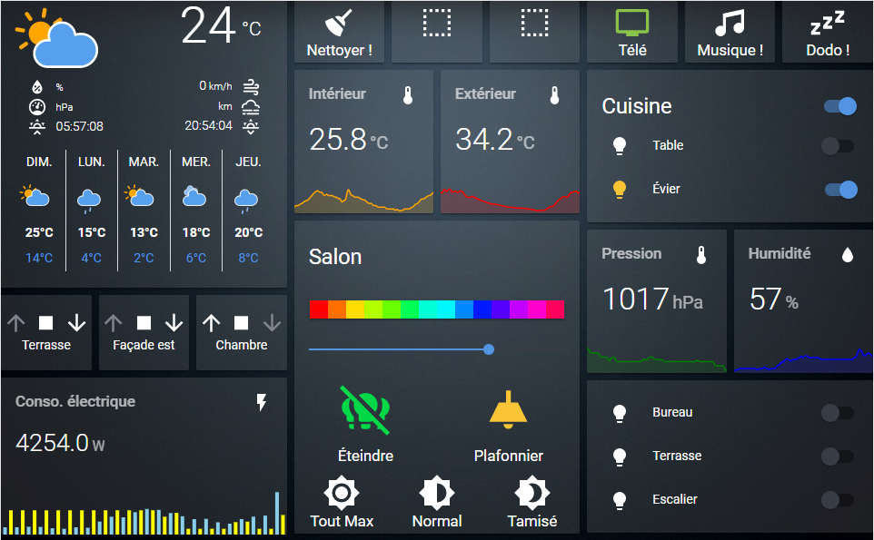
The Evaluation of biometric security in present time period
3. Mobile access and authentication
One of the most common applications of biometric technology is smartphone security. Apple, which first introduced the Touch ID solution - using fingerprint recognition technology - has since developed mobile phone security to use a number of biometric technologies, including face recognition, iris recognition and voice recognition.
4. Home Assistants
Every one familiar with Google Home, Alexa and Siri is already accustomed to using voice recognition as a biometric identifier. Google Assistant is compatible with a wide range of IoT (Internet of Things) devices, including lights, door locks, security cameras, security lights, and more that empower the assistant on Google Home and Android devices.

Slide 27
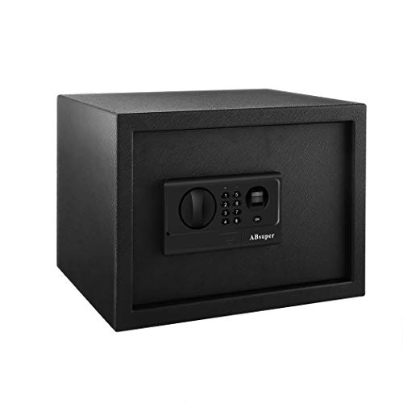
The Evaluation of biometric security in present time period
5.Cash protection
We mentioned how biometrics is used by banks; However, there is another financial application: biometric tariff protection. This technology has been integrated during transaction authentication processes and, now, mostly involves fingerprint scans.
6.Home security
Biometric technology allows a person to enter a home once its scanning unit has verified their identity. Access to office buildings, entire homes or specific rooms can be controlled by biometrics. Biometric locks deny the need for a key, which is instead activated by a fingerprint swipe.

Slide 28
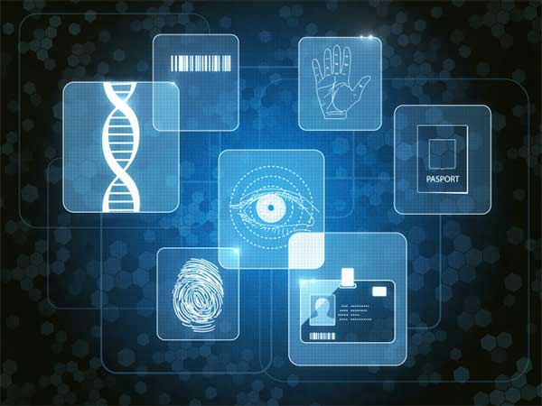
THE FUTURE OF BIOMETRIC SECURITY

Slide 29
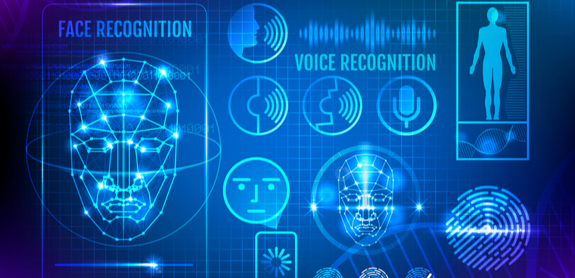
THE FUTURE OF BIOMETRIC SECURITY
i strongly believe that biometrics are the future of e-security systems, lots of institutions are joining biometrics by the day. Even the Windows 10 OS has incorporated a biometric security platform. Biometrics are also used in stadiums, airports, and banks across the world.
Government agencies and law enforcement have also migrated to biometric systems – therefore, it is very likely that even more organizations will follow suit in the near future.
While biometric security systems are not fool-proof, they are still faster, more cost-efficient (in the long run), and more accurate than traditional security methods.
Many biometric services are currently under development and testing. However, in a few years, these biometric technologies will be introduced everywhere. Plastic cards will soon fade into the background and fingerprint scanning will become a standard daily activity.
From monitoring your heart rate to fitting chips under your skin, as well as scanning intraocular vessels, tests are underway on the shape of your ear canals and more.

Slide 30
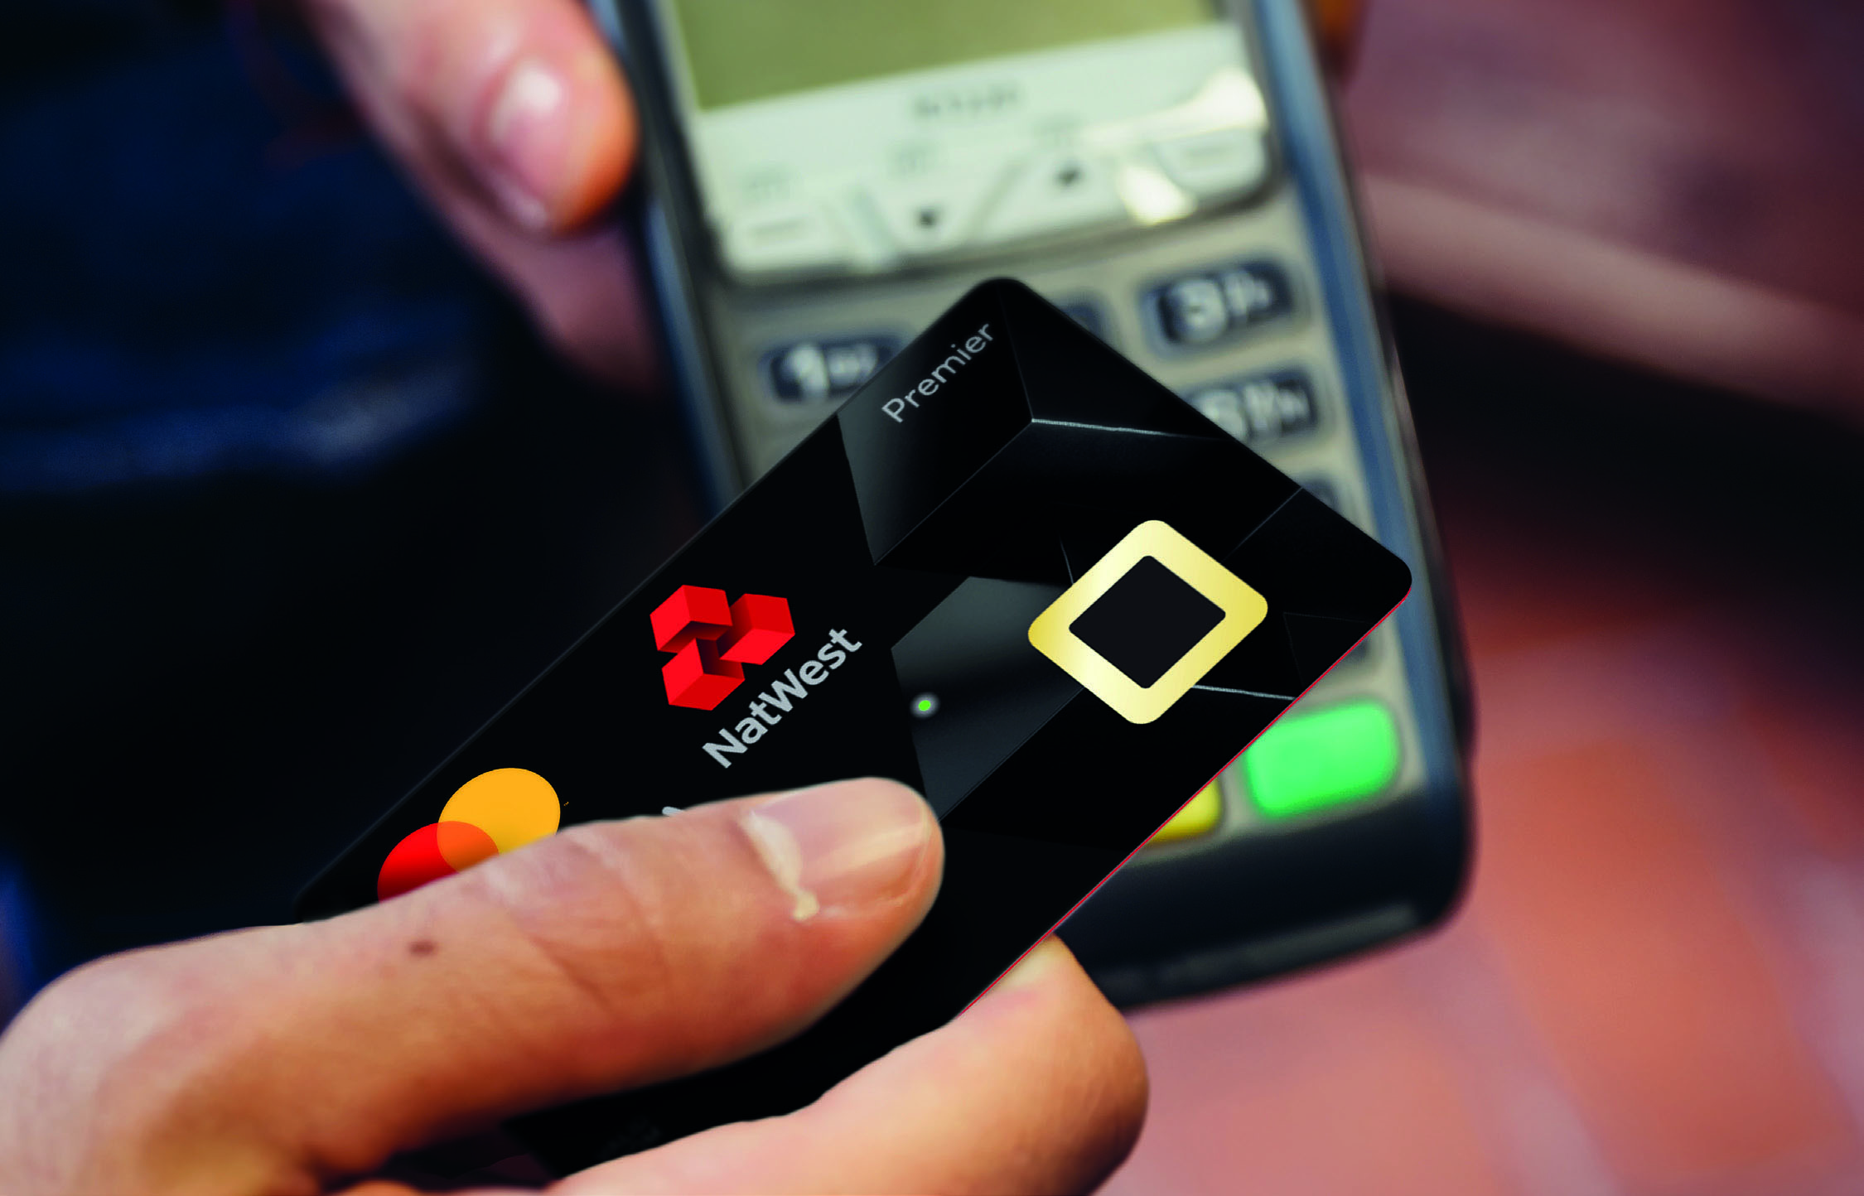
Banking's biometric future
Biometric technology will soon be the norm in the banking industry. According to Acuity Market Intelligence 1, physical credentials such as money and bank cards will disappear in the next decade or 'virtual credentials' - iris, voice, finger nerve - will last until 2030. By 2025, Aquity predicts that quality authentication for trillions of transactions is biometric.
Overall, while the public recognizes that data security is increasingly important, they are concerned that passwords and PINs are not evidence of fraud - and that biometrics responds by providing a quick, easy, and secure authentication process.
More specifically, the adoption of biometric technology is accelerated by the transition from external aspect recognition to internal (e.g., voice to neural recognition), which provides a highly streamlined and interesting customer experience.

Slide 31

The role of biometrics in cloud computing in the future
Cloud computing has become a new nature for most businesses. Nowadays, businesses of every size and industry use different cloud computing applications.
Cloud computing solutions have many advantages such as more time, mobility, and reduced cost, but one of the biggest challenges to this technology is security. has the potential to take cloud computing to the next level, improving the overall security of the cloud operating system.
One of the main reasons why biometric authentication is so successful is that it uses unique human characteristics for each person. Properties such as fingerprints and facial recognition are used in biometric authentication
Biometric concept started with fingerprints and then with the advancement of technology you should know that facial recognition will also become a part of biometric authentication

Slide 32
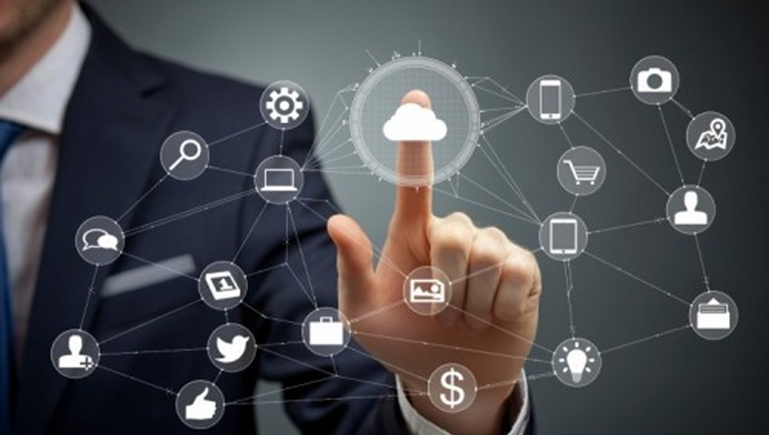
The role of biometrics in cloud computing in the future
There is no denying that the biometric solution is one of the most secure authentication methods, but it can become a very serious issue if anyone accesses the templates stored by the cloud provider.
This is why encryption is used to ensure that even if an unauthorized person accesses fingerprint templates, it is of no use to them. In encryption mode, the fingerprint templates stored at the end of the cloud user and the cloud provider are encrypted.
In order to improve security in biometric authentication, the system of multi-finger protection model is used. In this unique model, the cloud user has to register three fingerprint templates and then the user chooses a number for each fingerprint template.
This type of biometric authentication makes the cloud operating system more secure and terms such as unauthorized access become meaningless.

Slide 33
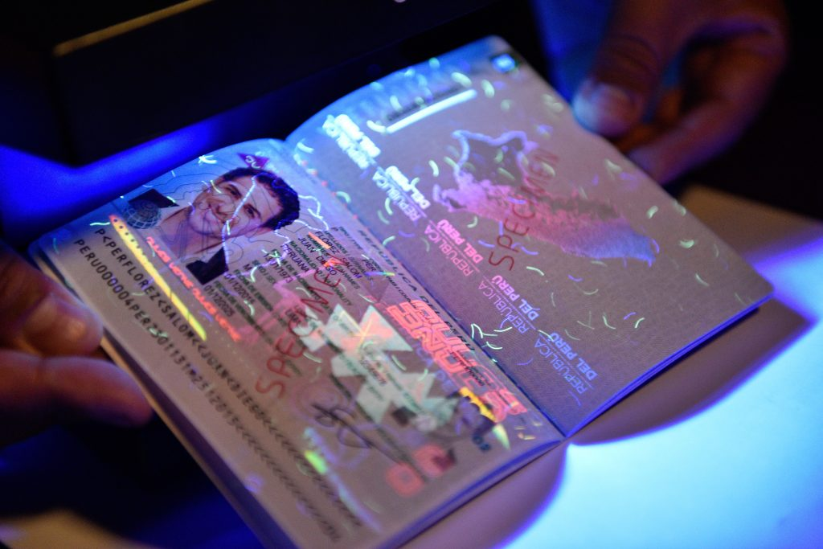
Biometric e-Passports
Also known as an e-passport or digital passport, a biometric passport contains an embedded microchip that holds your personal information. It looks like a traditional passport, but it has an international biometric logo on the bottom of the front cover. E-Passports launched to combat identity theft and terrorist threat
How does biometrics work?
Biometrics analyzes the unique physical characteristics of each person and includes retinal scans and fingerprints. The chip in your e-passport holds information about your face, such as the distance between your eyes, nose, mouth and ears, taken from the digital photo you provide when you apply for your passport.
What’s the point of a biometric passport?
Switching to ePassports was primarily to improve safety and security. The innovative chip can hold a lot of unique data in it, making the passport much harder to replicate or forge. It’s also much easier to identify people using the detailed set of data stored through biometrics.
You'll feel the benefit of travelling with a digital passport when you're able to use the ePassport gate in border control which makes getting through airport security much more efficient.

Slide 34
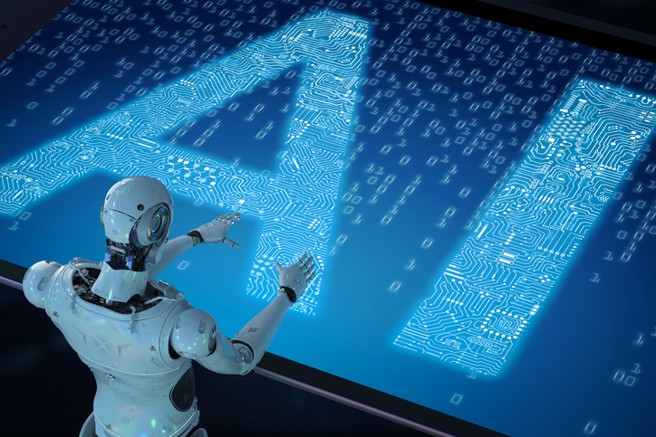
Artificial intelligence (AI) will transform security, authentication.
Fraud is not an insurmountable problem, AI will help. Companies can stack AI in ways that help transform their customer experience and services and protect data. Biometrics is one such example; It includes a variety of methods for customer recognition, such as voice, behavior, and facial recognition. Identify and promote best practices and help mitigate security risks. AI and biometrics together prevent billions of dollars in losses from fraud. With the help of AI and biometrics, we will build a more secure, more digital, foundation for the future.

Slide 35
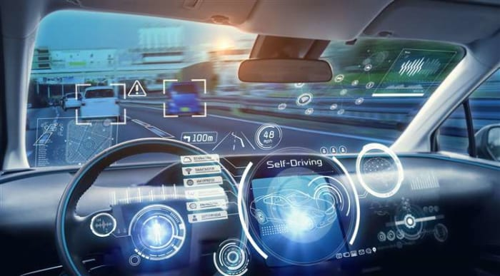
Biometric Car Technologies
Many automakers are now introducing this technology to vehicles to avoid many problems such as vehicle theft. You can open your vehicle very easily by using your smartphone or Bluetooth device. After that, when you get in the car, it checks that you are the right person and will alert you in case of emergency. Car owners can set up biometric settings such as fingerprints or retina scans. After that, no unauthorized person can open the car. Similarly biometric technology will be embedded in the seats, which will be very helpful in monitoring driving stress and tension. With that, there will always be physical changes in the automobile. Biometric technology can collect data on everything, including the steering, accelerator and many other components to determine. Also, if there are signs of anxiety, the car will suggest that the driver take a few minutes to rest.

Slide 36
New Technologies in Biometrics
Palm Vein Scan
3D Face Recognition
DNA biometrics
Keystroke biometrics

Slide 37
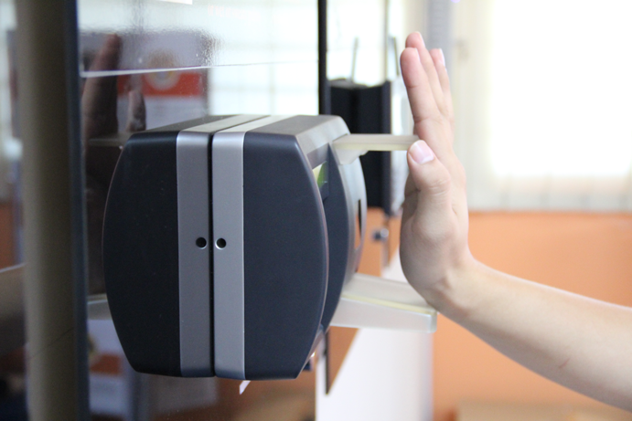
Palm Vein Scan
Palm vein scan is a powerful, relatively new biometric that uses the internal vein pattern of your palm to identify you. Similar to fingerprint, each person's palm vein pattern is unique and doesn't change.
However, this unique identification method has several key security and privacy advantages that traditional biometrics (such as fingerprint and facial recognition) don't offer.

Slide 38
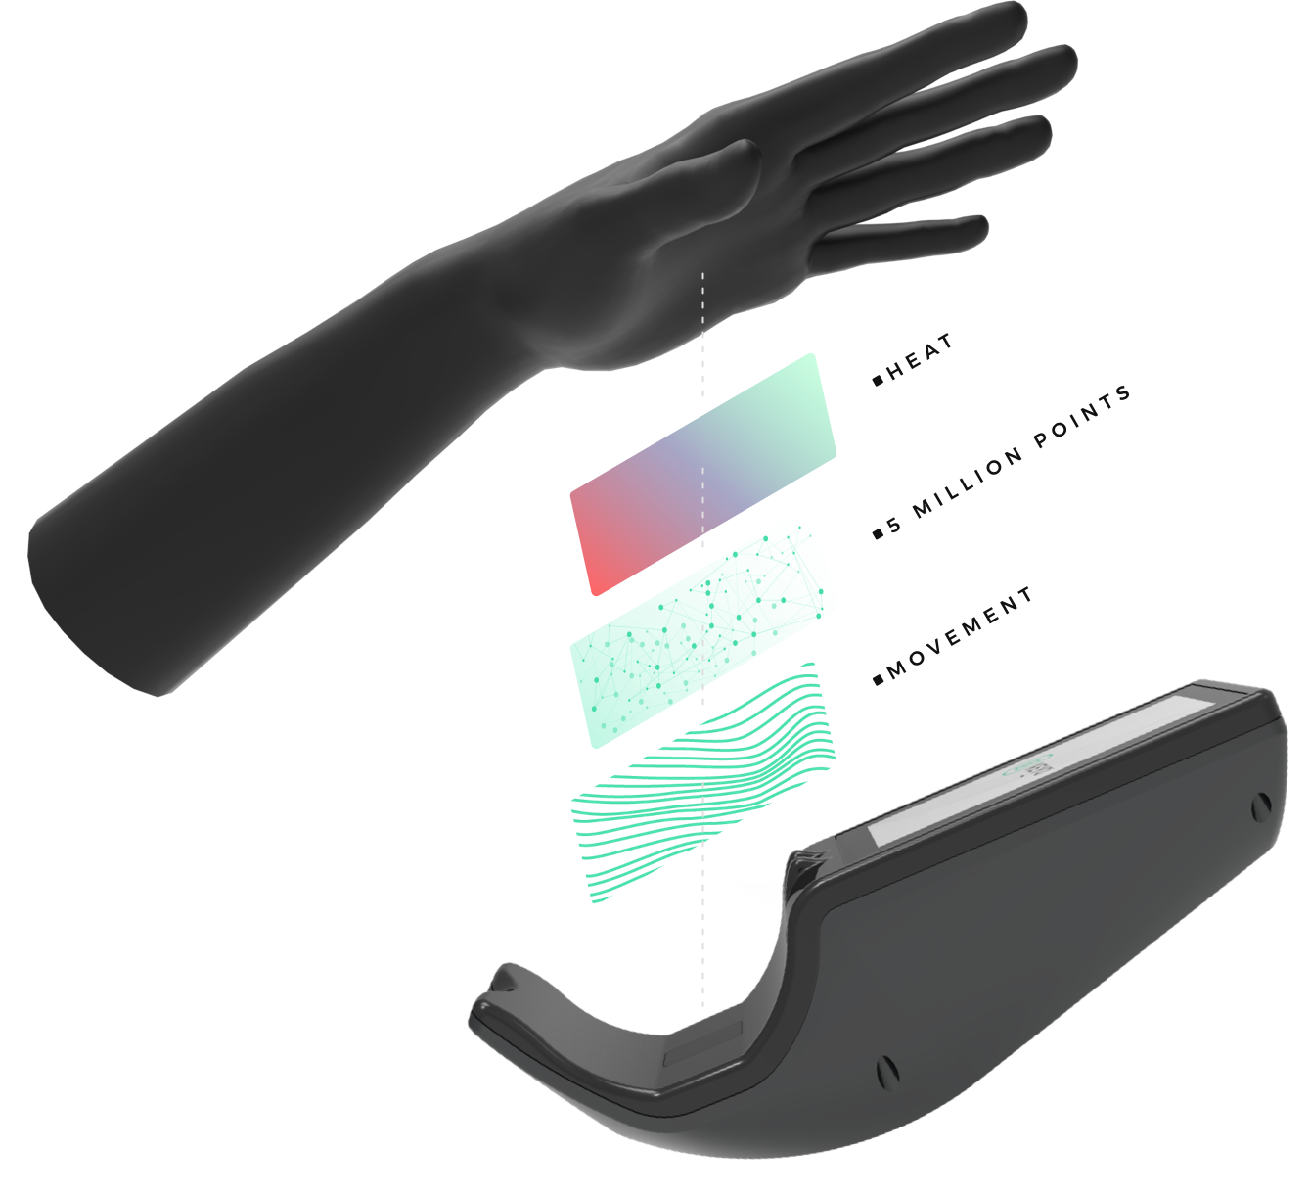
How does a palm vein scanner work?
Palm vein scan is a biometric that works by using infrared light to map the unique vein structure of your palm, capturing over 5 million data points. The palm vein scanner then converts these data points into a unique encrypted code that becomes your biometric ID.
There is one key feature that makes palm vein recognition stand out from other biometrics. Unlike your fingerprint, iris, or face, your palm vein pattern is internal.
Because your palm vein pattern is concealed inside your hand, it is not exposed like other biometrics. This gives it several unique advantages that make it arguably the most advanced biometric on the market

Slide 39
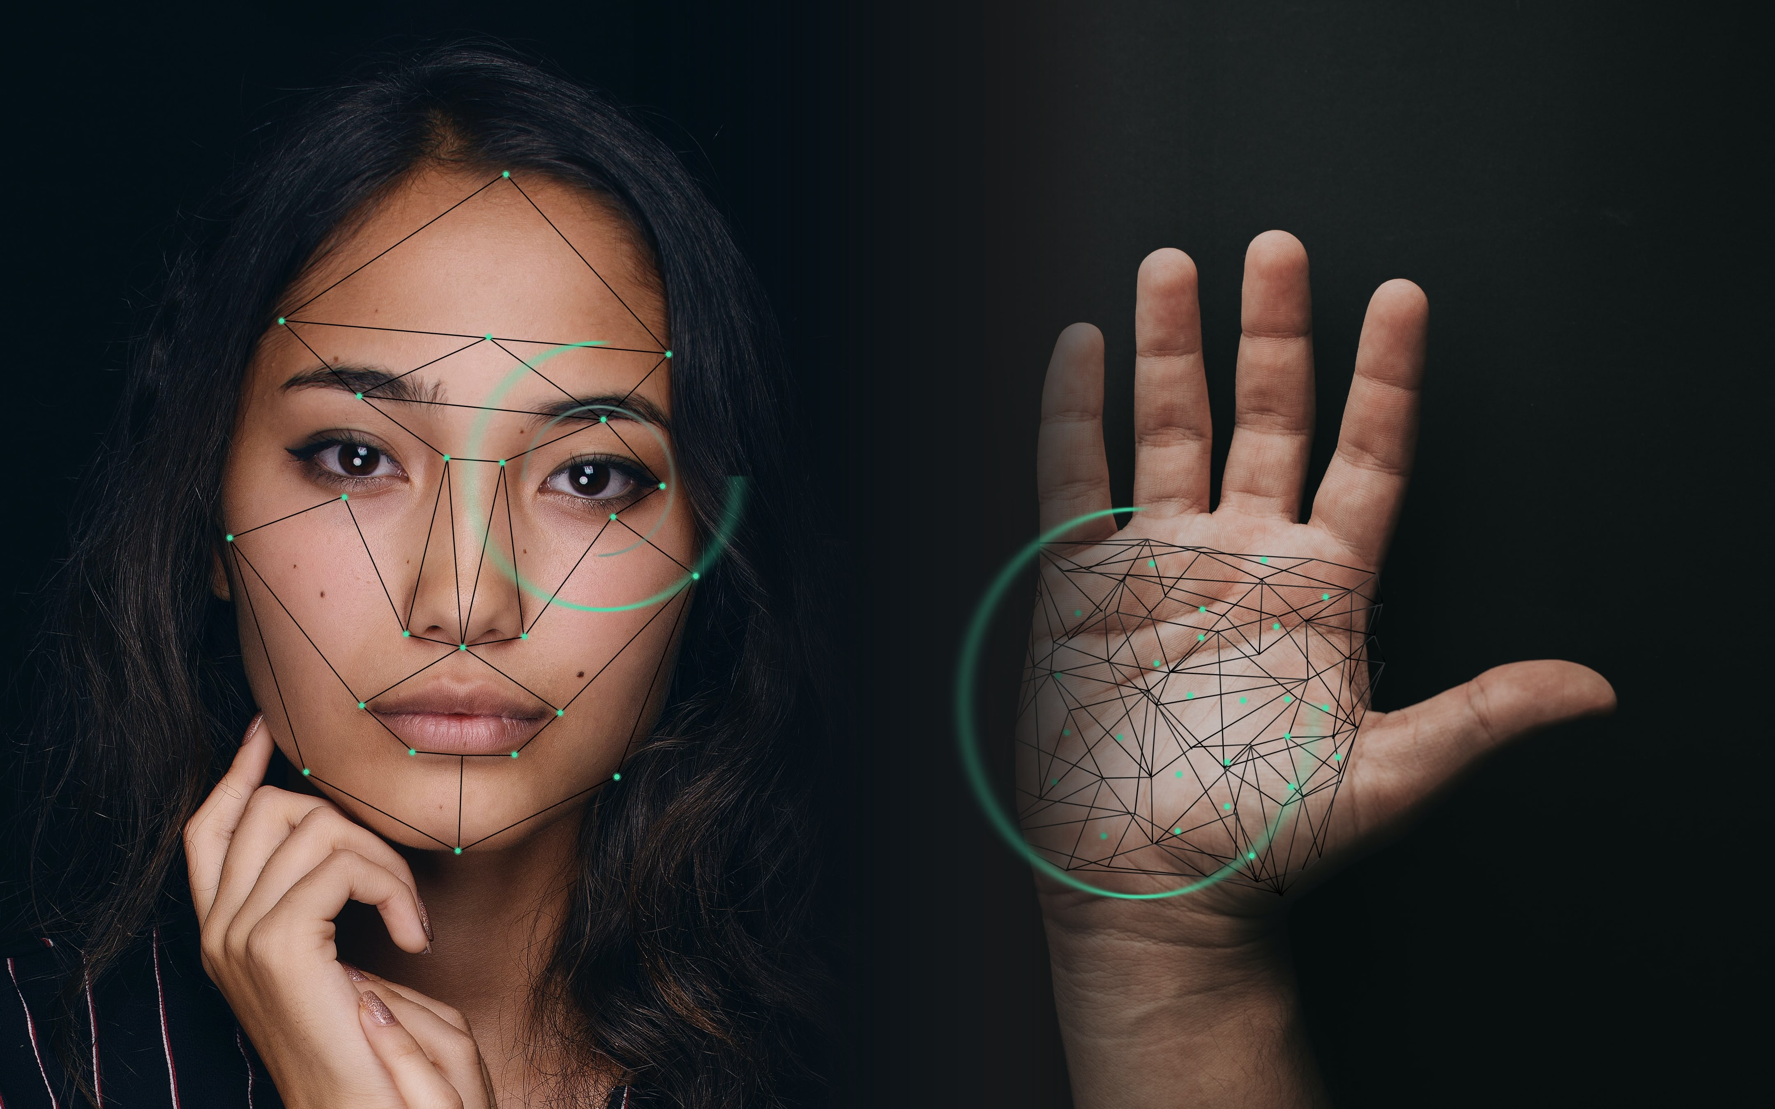
4 Reasons Why Palm Vein Scan is the Best Biometric
1. Security
Palm vein scan is more secure than other biometrics because it's never exposed. Think of biometrics like a password. But instead of using numbers to log in, you're using your own body. But certain biometrics such as facial recognition have a key flaw: they are exposed. palm vein, since your biometric code is concealed inside your hand, it's very difficult for a thief to steal this pattern and create a replica with it.
2. Accuracy
Since the palm has a larger surface area than the finger or iris, for example, the palm vein scanner is able to capture a larger number of data points. This gives it an accuracy advantage compared to other biometrics. Keyo's palm vein scanner captures over 5 million data points in the palm, giving it unparalleled accuracy.

Slide 40
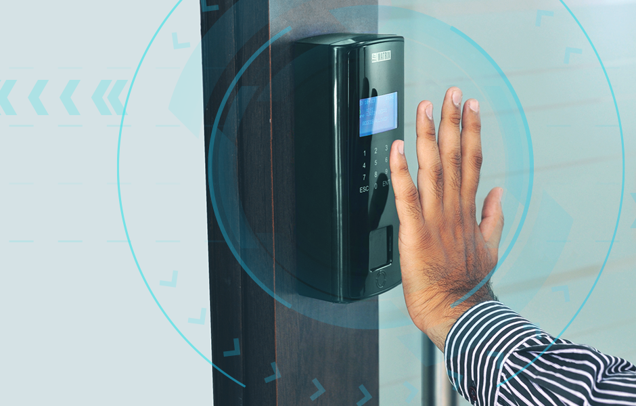
4 Reasons Why Palm Vein Scan is the Best Biometric
3. Privacy
Since palm vein is internal to the body, it can only be captured via a close-up, high-definition camera in combination with UV light. So unless you deliberately scan your hand on the palm vein device, it is very difficult for it to be captured.
This has several benefits for companies looking to implement palm vein in their organization:
Since it's privacy-focused, palm vein may be seen as more trustworthy by customers and/or staff, making it easier for them to adopt.
Since consent is the number-one requirement in privacy regulations around the world, palm-vein's consent-based design makes it easier for you to gain compliance with these regulations and avoid legal issues.
4. Reliability
Each person's palm vein pattern remains relatively stable throughout life, so the chance that a registered user will have to re-enroll in the future is very low. Certain other biometrics are more susceptible to change over time. Fingerprint, for example, Cuts and abrasions on the finger make it possible for an authorized user to be unrecognized by fingerprint scanners and incorrectly denied access. Palm Vein more stable over time.

Slide 41
3D Face Recognition
3D face recognition has become a popular research direction in both industry and education. It benefits from traditional 2D face recognition such as the natural authentication process and a wide range of applications. Furthermore, 3D face recognition systems can accurately identify human faces even under dim lighting and with different facial expressions and expressions, making it difficult for 2D face recognition systems to operate in such conditions.
The emerging trend in facial recognition software is to use a 3D model, which claims to offer greater accuracy. Real-time 3D imaging of a person's facial surface uses 3D facial recognition to distinguish features of the face - where the hard tissue and bone are most clearly visible, such as the curves of the eye socket, nose, and chin. All of these areas are unique and will not change over time. Using light-free depth and the axis of measurement, 3D facial recognition can be used even in the dark and is capable of recognizing an object from different perspectives with the ability to detect up to 90 degrees (one face in profile).
Prior to this, security guards had to make a manual identification of a person that took too much time and did not boast of high accuracy. But today, facial recognition is completely independent of the identification process, and not only takes a few seconds but is incredibly accurate.

Slide 42

DNA biometrics
Considering that 0.10 percent of a person's entire gene is unique to them, DNA testing can be very difficult and inaccurate. Less than one in a hundred billion if 2 people who share the same DNA profile read 26 different bands.
However, even the most basic DNA testing requires sophisticated and expensive technology. Obviously, this requires a physical model, so the person must be physically fit with the test equipment and can be the most invasive way to test
Although this process is very precise, it is not as accurate as DNA fingerprinting. According to national standards and technology institutes, fingerprint comparisons are 98.6% time accurate on one finger. DNA fingerprinting time is 99.9% accurate.

Slide 43
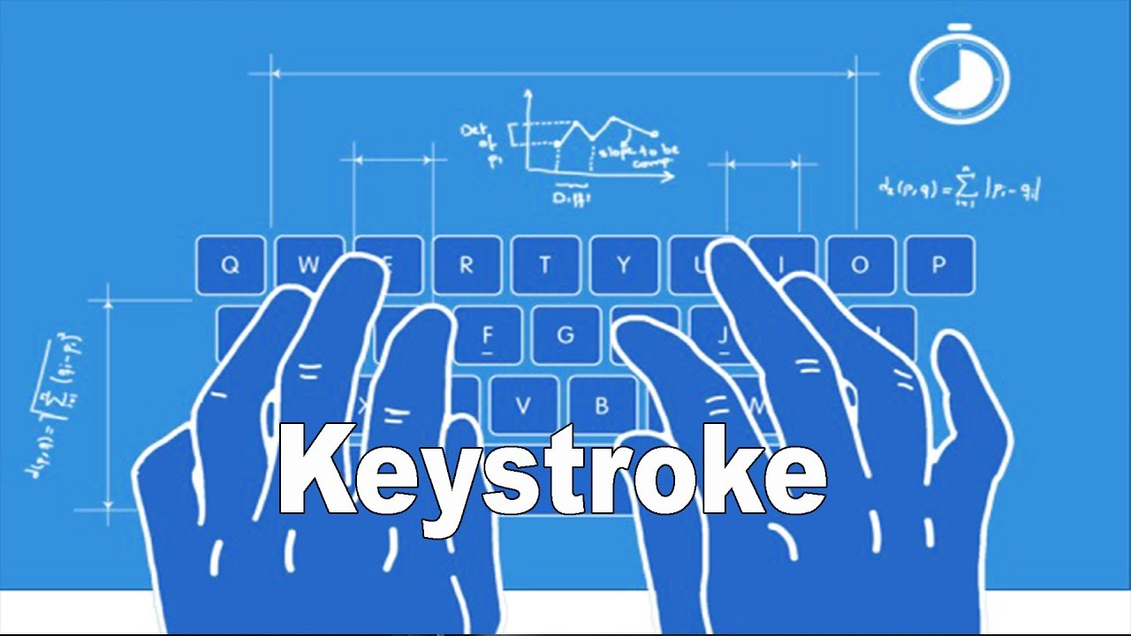
Keystroke biometrics
Keystroke authentication is defined as the process of measuring and evaluating typing rhythms on digital devices, including computer keyboards, mobile phones, and touch screen panels.
Keystroke dynamics use a unique biometric template to identify individuals based on typing, rhythm, and speed.
Typing patterns can be irregular and inconsistent because the muscles that contract and the sweaty hands can significantly change a person’s typing pattern. Furthermore, MIT found that typing methods vary depending on the type of keyboard, which can significantly complicate verification.
The software can accurately measure the occurrence of keystrokes in milliseconds. Therefore, it is impossible to copy one's keystroke pattern at such high resolution without exertionable effort.

Slide 44
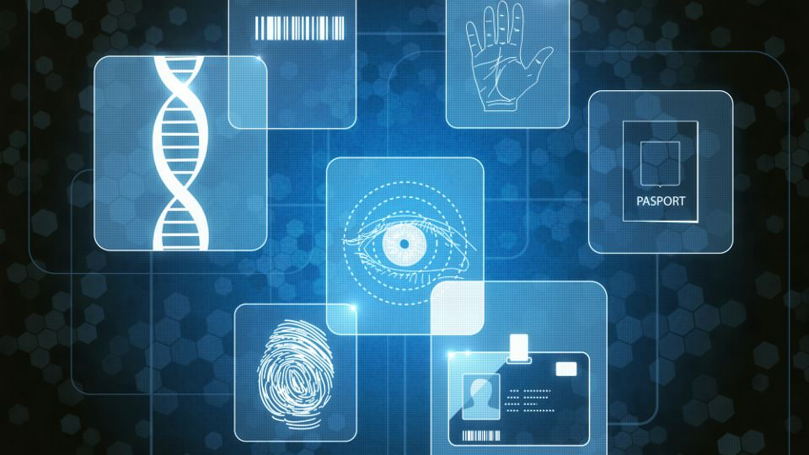
Conclusion
Despite many doubts about the biometric security system, biometric security system identify individuals with the highest level of certainty
Mainly fingerprint biometric provides a very robust mature solution to a biometric technology. All though many new biometric technologies will be used in future, fingerprint system will mainly use in day to day life
Many companies still don’t have access to biometric technology due to the fact the employers have many security concern about biometric technologies, but in the future, many companies will use biometric technology as a shield to allay their fears
biometrics remains a growing way to verify identity for cybersecurity systems
Biometric technologies provide highly demonstrative solutions to security despite the risks the system are flexible and difficult to duplicate in addition these system will achieve very long-term growth in the future.
For my thoughts, in the future there will be a situation where we have to alive with biometric technology facilities day to day, Because biometric technology is becoming an integral parts of most basic needs, from medical banking vahicle, travel and money ect.

